Slide 1





Pixels to Words
Image Captioning Using CNN and LSTM
BAN 676- Deep Learning for Business Applications
Group 2
Notes:
Good afternoon everyone we are group 2 and our project is Pixels to Words
We are doing Image captioning Using CNN and LSTM models
Let me introduce our team
Let's start with Motivation of the project

Slide 2

Our Team
Hemanth Varma Pericherla
Venkata Naga Anirudh Chaganti
Vaishnavi Karingala
Rithika Pagadala
Rupesh Maadas

Slide 3


Motivation of the project
Automating image captioning bridges the gap between visual data and natural language, aiding applications like accessibility for the visually impaired, content creation, and surveillance.
Advances in deep learning enable combining CNNs for image understanding and LSTMs for sequence generation.
Notes:
Imagine a world where computers can not only see images but describe them just like we do. What if your device could caption photos in real-time, making visual content more accessible to everyone, including the visually impaired? That’s the incredible potential of image captioning!
Advances in deep learning make this possible. CNNs extract features from images, while LSTMs generate coherent descriptions. By combining these, we create a system that can effectively interpret and describe visual content.

Slide 4
Research Questions
Effectiveness: How effectively can CNN + LSTM generate meaningful and accurate captions for diverse images?
Generalization: Can the model generalize well to unseen images, and how can we minimize redundancy in captions?
How does the model performance improve when incorporating techniques like transfer learning?
Notes:
We focused on three key research questions:
Effectiveness: How well can CNN + LSTM generate accurate captions for diverse images?
Generalization: Can the model handle unseen images and reduce redundancy in captions?
Optimization: How does transfer learning improve the model’s performance on complex datasets?

Slide 5
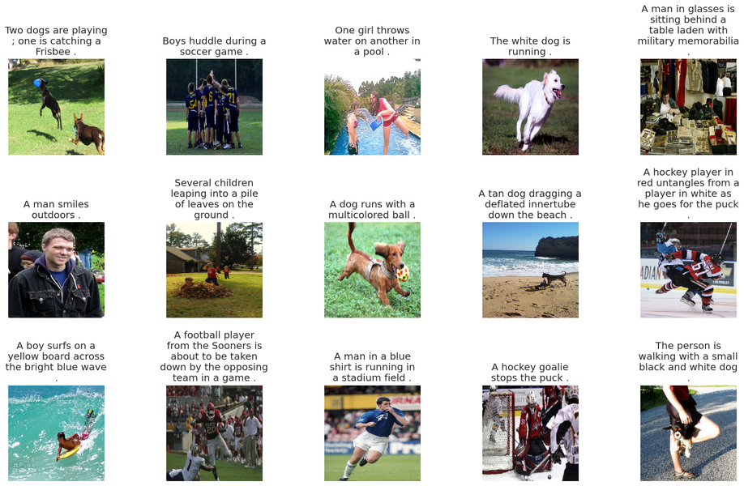
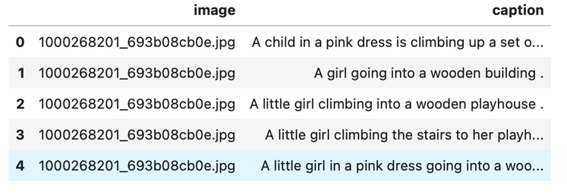
Data
Image Dataset
Source: Flickr8k Dataset
Content: 8,000 images featuring diverse activities, objects, and scenes.
Caption Dataset
Each image is paired with one representative caption for clarity and simplicity.
Dataset Characteristics
Visual Diversity: Includes actions like playing, running, swimming,
and scenes such as beaches, parks, and sports events.
Applications: Supports training models for image-to-text tasks and contextual understanding.
Notes:
- Flickr8k Dataset with 8,000 images, paired with 40,455 captions, each image having 5 diverse textual descriptions, covering activities like playing, running, and scenes such as beaches and parks.
- Each image is paired with a representative caption for clarity and simplicity
- Each caption offers a unique perspective on the image.
- Supports training models for image-to-text tasks and contextual understanding.

Slide 6
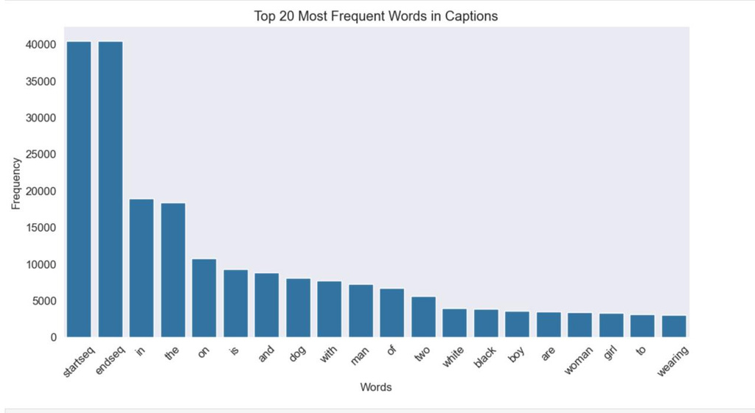
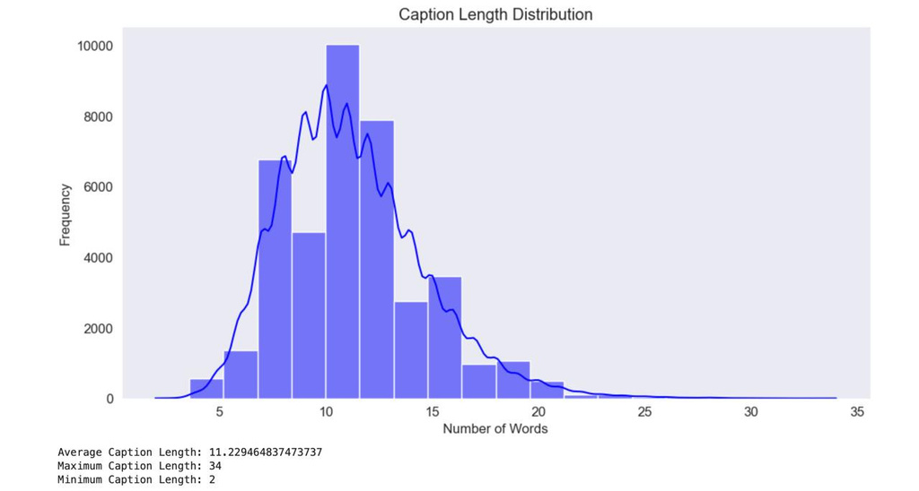
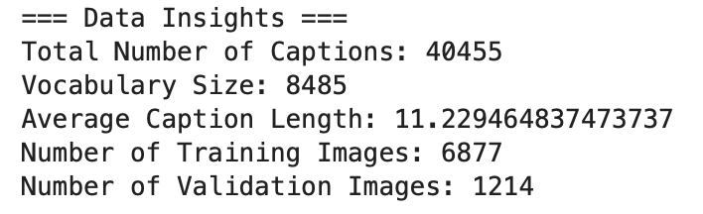
Exploratory Data Analysis
Most Frequent Words in Captions:
"startseq" and "endseq" are structural markers.
Common words include "dog," "man," "woman," "white," etc.
Caption Length Distribution:
Normal distribution centered around 10-12 words.
Few captions exceed 20 words.
Notes:
- Special tokens "startseq" and "endseq" are appended to each caption to guide the sequence generation during training and inference.
- Data Statistics
Total Captions: 40,455.
Vocabulary Size: 8,485 unique words.
Average Caption Length: ~11 words.
Dataset Split:
Training Images: 6,877.
Validation Images: 1,214.

Slide 7
Approach
1
2
3
Image and Text Preprocessing:
Clean captions, tokenize, and append "startseq" and "endseq."
Images are resized to 224 which is the usual sizes used by the architecture
Model Architecture:
Encoder: DenseNet201 extracts features from images.
Decoder: LSTM generates text sequences.
Combined:
Dense layers for feature embedding.
Dropout for regularization.
Optimization:
Loss: Categorical cross-entropy.
Optimizer: Adam with learning rate decay.
Early stopping for convergence.
Notes:
The Approach starts with image and text processing, where images are resized to 224x224 (a standard input size for DenseNet201) and converted to RGB format to ensure consistency across all images. Captions are cleaned by removing noise, punctuation, and unnecessary characters, then tokenized into individual words. Special tokens "startseq" and "endseq" are appended to each caption to guide the sequence generation during training and inference.
The model architecture consists of an Encoder, where DenseNet201 extracts compact feature representations from the images, and a Decoder, where an LSTM network generates descriptive captions word by word.
For optimization, the model uses categorical cross-entropy as the loss function to compare predicted words with actual words, while the Adam optimizer with learning rate decay ensures smooth and efficient convergence.

Slide 8
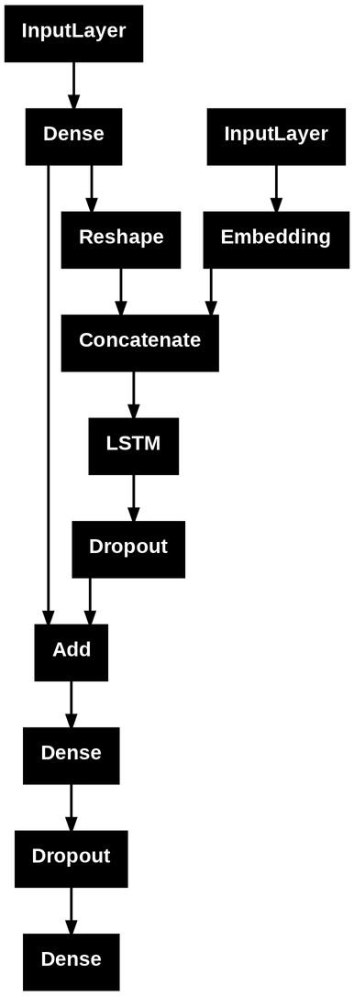
Model Architecture
Combines CNN (Encoder) and LSTM (Decoder) for image captioning.
Encoder:
Extracts image features using DenseNet201.
Dense and Reshape layers process features for the decoder.
Decoder:
Embedding layer processes tokenized captions.
LSTM generates sequences by combining image and caption features.
Output:
Dense layers predict words.
Dropout layers reduce overfitting.

Slide 9
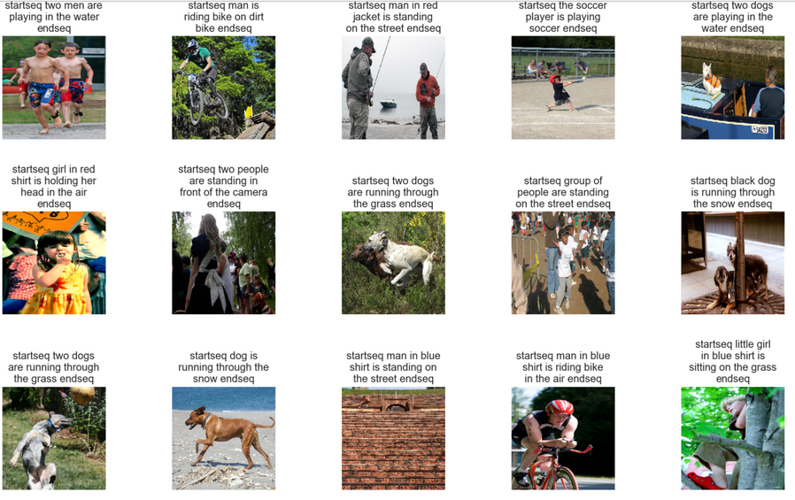
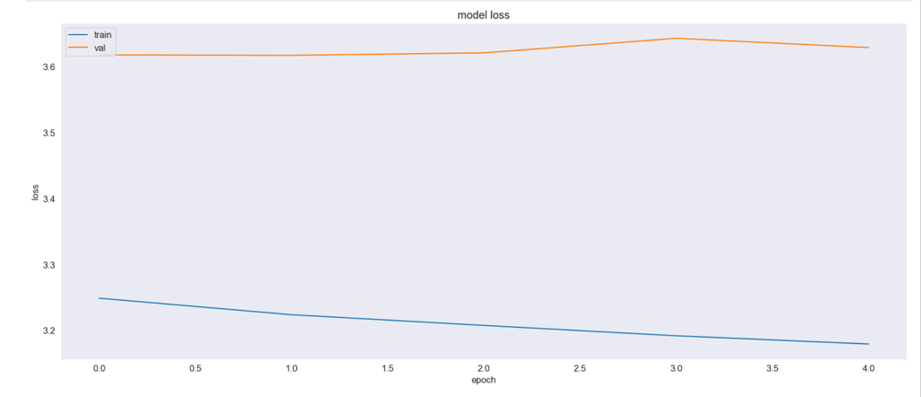
Result
The steady decline in training loss indicates good learning behavior during training.
The increasing or stagnating validation loss may suggest overfitting to the training data.
Further steps like regularization (e.g., dropout, L2) or early stopping could help improve generalization.
Our model achieved a BLEU score of 0.4, which is a moderate score for a task as complex as image captioning. Given the diversity and challenges of the dataset, this result indicates that the model is learning to generate meaningful and somewhat accurate captions.
The captions capture the essence of most images well, reflecting the model's understanding of the visual content.
Some captions are more detailed (e.g., "girl in red shirt is holding her head in the air"), indicating the model’s ability to pick up finer details.

Slide 10
Contributions and Implications
Contributions
Demonstrated the effectiveness of CNN + LSTM architectures for image captioning, generating meaningful and coherent captions.
Established a baseline for future improvements with attention mechanisms, beam search, and data augmentation.
Implications
Applications include accessibility tools, enhanced search engines, and automated social media content generation.
Provides insights for extending image-to-text generation models to domains like healthcare and e-commerce.
Notes:
first read the contributions
"The results of this project have significant practical applications across various industries, especially where generating textual descriptions from images can enhance user experiences and workflows."
for example our applications include
Accessibility - It can Help visually impaired users with descriptive captions via assistive tools.
Search Engines-It can help Enhance image indexing for better search results.and coming to social media content generation it can be used to
Automate captions for consistent, time-saving content.
Our Project provides insights (read the point in slide) for example
It can generate descriptions for medical images to aid doctors or
It can automate product descriptions for efficient cataloging
Impact:
Bridges visual and textual data, transforming accessibility and efficiency across industries.
coming to the Closing Thought-
"This project demonstrates the versatility of CNN + LSTM architectures and paves the way for improvements that can transform accessibility, search, and automated content generation."
Thank you and All the best to everyone who are presenting next.

Slide 11
Q&A Session

Slide 12
Thank You

